Slide 1


GeeksHacking - Geek Connect: Find Your Tribe IRL
TEAM PHARSETECH
Shubham Jariwala
Aidan Ong
Leonel Lim
Tristan Amadeus Surya
Stephen Ng
Notes:
Hello everyone, we are PharseTech. Today, my team is excited to present our platform for fostering meaningful, real-world connections within the geek community.

Slide 2



Overview
01
Our Mission and Vision
02
What is Our Solution?
03
Considerations
04
Appendix / Addressing Painpoints
Notes:
Here's what we'll cover for today!

Slide 3
01
Mission
Notes:
mission

Slide 4

Mission
How do we foster real-world connections, inclusiveness and cohesion within
the geek community?
Dynamic and Inclusive
A Celebration of Geek Culture that Thrives Offline & Online
Notes:
Our team sought to create a dynamic and inclusive platform that empowers geeks to connect with like-minded peers, building a community that blends the best of virtual interactions and real-world engagement, and celebrates geek culture!

Slide 5
02
What is our solution?
Notes:
what is our solution?

Slide 6
Application Overview
Application begins by taking user input. Information about the user is supplied to the application by the user
01
Through our unsupervised learning algorithm, 3 of the most compatible tribe groups for the user would be recommended to the user
The user may choose to join one of them (admin determines the minimum and maximum number of members allowed in a tribe)
02
Our solution: A platform which forms your tribe complemented with an events page of various activities for all
Events tab with broad range of activities all regardless of whether you are in a tribe
03
Notes:
Our solution has 2 key aspects.
Our approach begins by gathering user input, leveraging an unsupervised learning algorithm to recommend three of the most compatible tribe groups. Users can then join a tribe that best fits their interests, with tribe sizes managed by platform administrators.
Additionally, an events tab provides a diverse range of activities for all, ensuring continuous engagement beyond tribe participation.

Slide 7

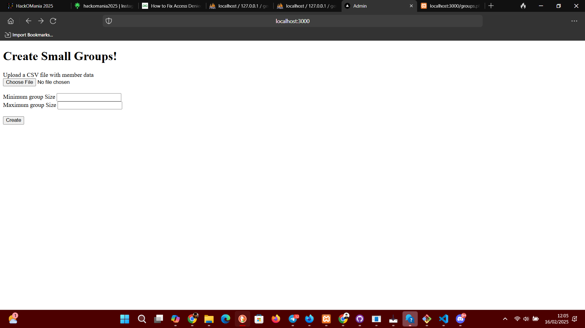
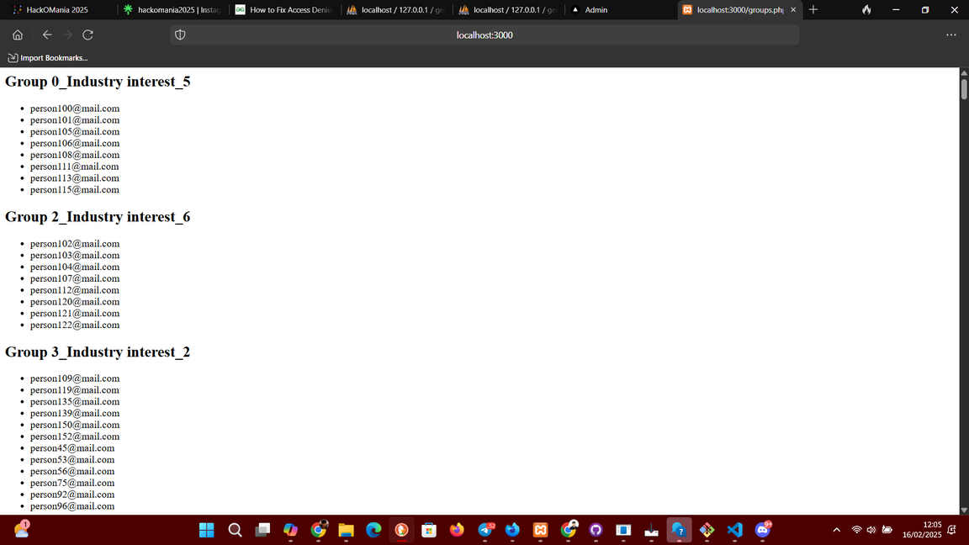
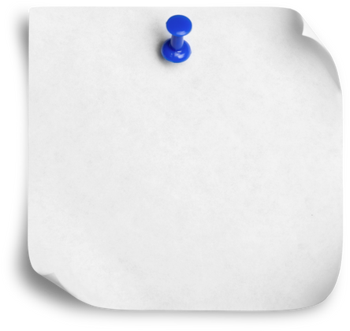


Tribe Filtering
Tribe Formation
Application Interface
Admin Page
Tribes Page
A disciplined method for gathering user information and filtering people into clusters (in order):
Location
Hobbies, learning interests
Note: Grouping preferences are utilised to grant weighted importances in our sieving process
Exclusion of race and gender as filters
How we filter GeekHackers into tribes?
Find out how!
Notes:
When connecting with others, it's best to have shared interests and opportunities to meet in person.
Our approach to building communities first groups users based on their location.
Then, based on a users' declared preferences, tribes sharing similar hobbies and learning interests are recommended, allowing a user to explore its' members profiles to find the tribe that suits them best!

Slide 8
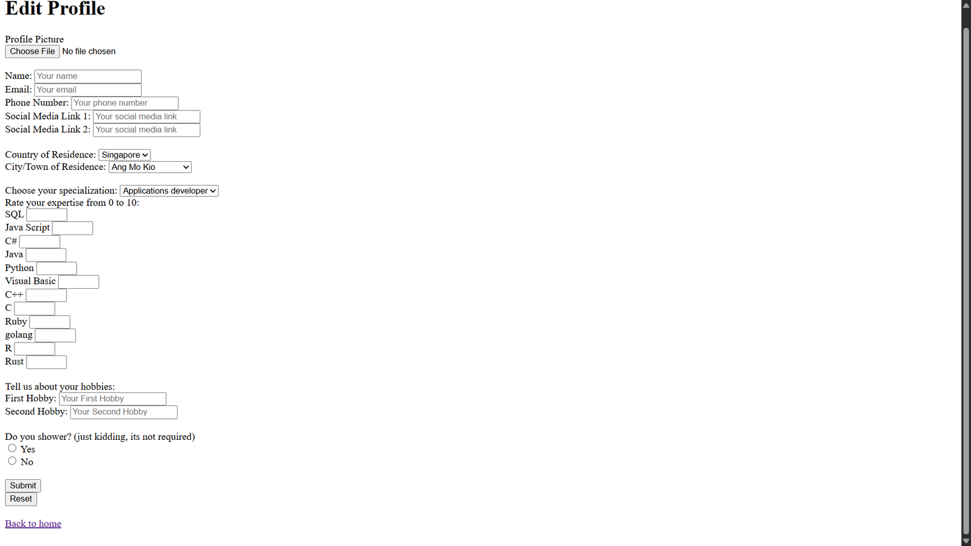
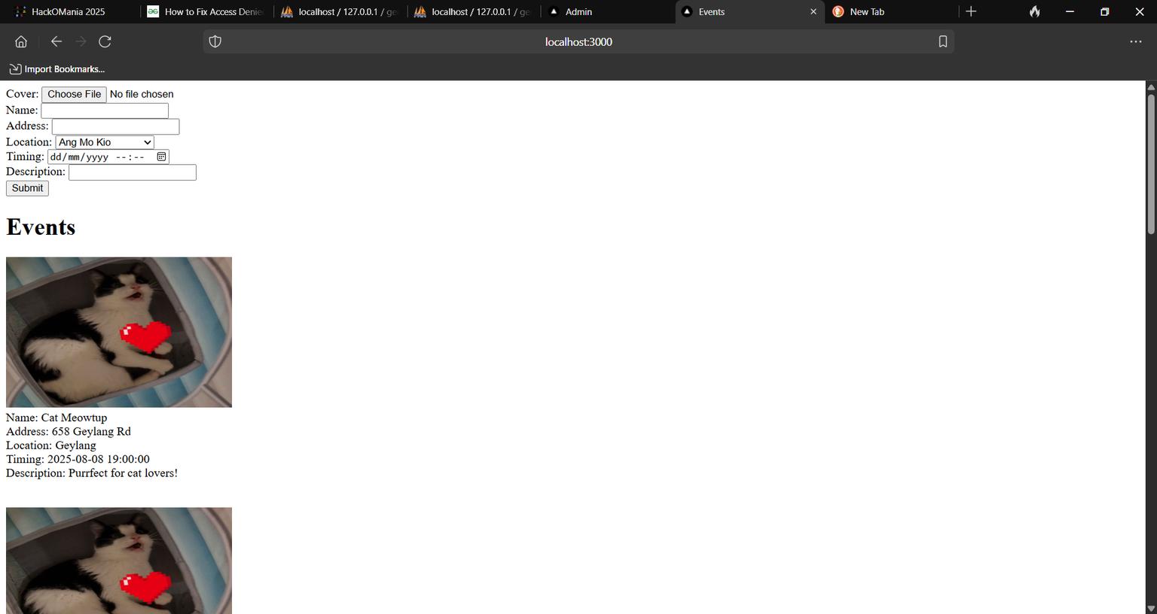
Demo
Events Page
User Page

Slide 9
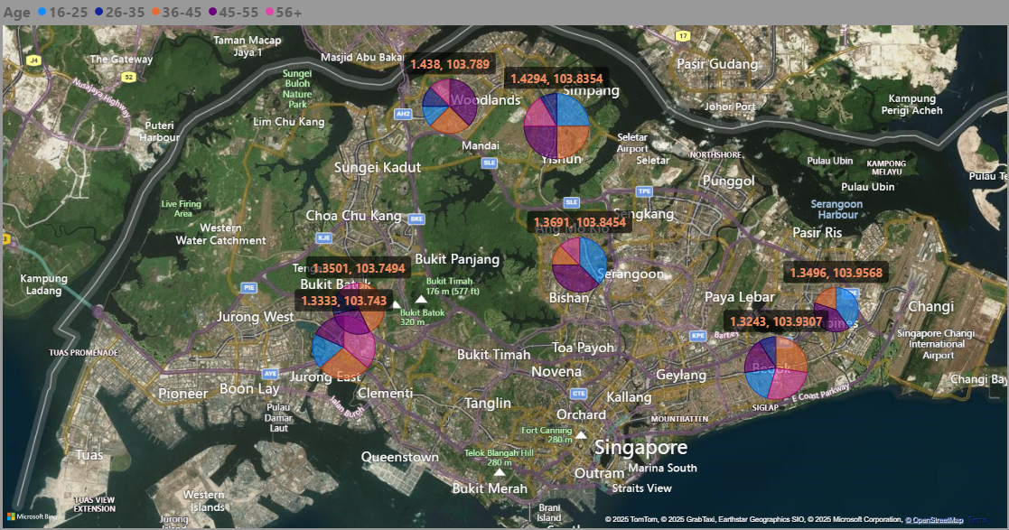
Use of GeoCoding API -
filters location
Converts the location entered by the user into latitude and longitude
Grouping by town is more relevant attributed to ability to find geographically close towns (arduous task to do the same with North, South, East, West, Central directions)
Notes:
DIVING deeper into our 1st filter, location. By leveraging Google Maps' Geocoding API, we convert the users' towns into geographical coordinates.
Why did we choose to segregate by town? We noticed town clusters would have geographically proximate Unlike north south east west. A North coordinate can be very far from another North but close to a Central location

Slide 10
03
Considerations

Slide 11
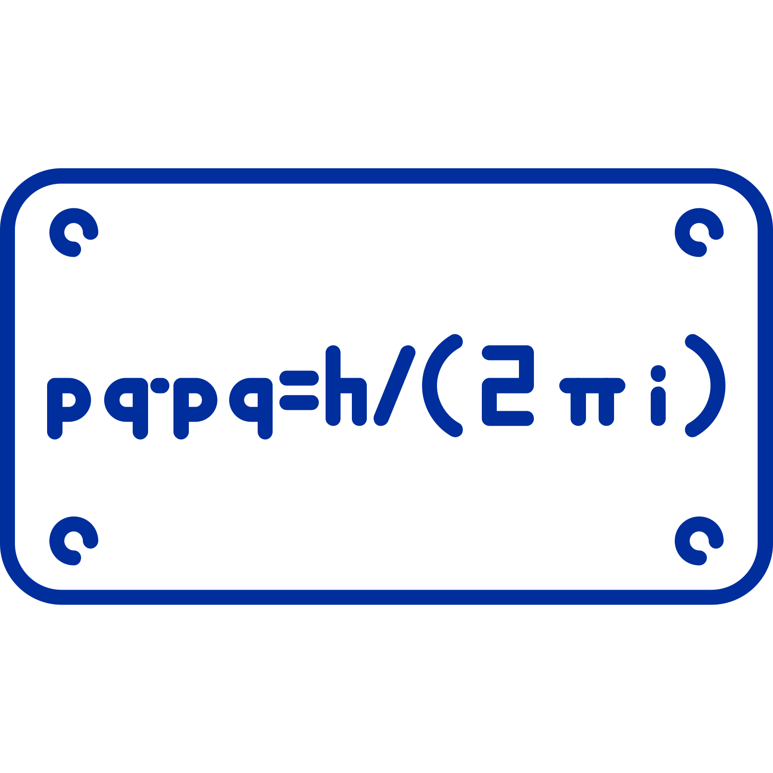



Considerations
Analysis
Technical Exploration
Geocoding API (explained earlier!) and k-means clustering (lat-long coordinates)
k-means groups code learning, k-modes groups hobbies, normal filter for industry roles
Impose constraints on tribe sizes (6-11 members)
Match NEW users with decision trees from database for smart real-time sorting.
Forced k-means prevented outliers.
Outperformed density-based clustering methods that were too sensitive to noise.
Cost Feasibility
GeekHackers volunteers would be maintaining the website, so we will have no maintainence costs.
We can open a GoFundMe for raising funds towards further development of the site
Uniqueness and Inclusiveness of ideas
Allow GeekHackers to host their own events or propose events to be held and promoted on the application to set a sense of belonging onto everyone
Notes:
I'll be sharing on the relevant technical and practical considerations.
For the tribe filtering algorithm,
We use k-means clustering to group nearby users and those with similar coding confidence. For categorical traits like hobbies and roles, we apply k-modes. To ensure meaningful interactions, tribe sizes are limited.
For cost feasibility, volunteers can maintain the site, with fundraising for more servers and skilled developers as a scaling option. To encourage user growth and interaction, users can host their own events, or share links to ongoing local events to be promoted on the platform, facilitating team formation and fostering a greater sense of belonging amongst members.

Slide 12


Considerations
Analysis
Interest based
Explore more nuanced matching techniques to form focus groups of admin specified number of tribe members (6-11 members to enable the socially anxious to feel comfortable)
Envisioning greater inclusiveness through prioritising users’ predilections whilst being open to their ideas
Community Focus
Connect users with relevant events and meetups
Creation of a page showcasing events for users, filterable by geographical proximity, interests, hobbies, commanalities with other users etc.
Geeky Community
To encourage a more geeky experience, we could raise encouraging the sharing of passions
This is a community effort so both the users and admins can adopt an understanding and accepting attitude towards uniqueness and people’s passions. Encouraging everyone to adopt such attitudes could be supported by supportive messages by the admins
Social Impact
The platform can combat social isolation by being a medium for gaining new friends
Combats social anxiety of some geeks with social anxiety
Notes:
A focused approach with admin controlled member count limits is adopted so the admins may decide most suitable group sizings for its members. Filters based on YOUR interests and being open to event suggestions are to make you feel treasured in this community.
Striving for a geeky impact is encouraging a supportive attitude towards openness and accepting of each others' unique differences.
There's greater opportunities for meetups under comfortable settings and finding others who share common ground to accomodate your social comfort.

Slide 13

Thank you.
Ask us questions!
Notes:
And with that we rest our case. Thank you.

Slide 14
04
Appendix
Tackling Pain Points
Notes:
In conclusion, biases plague our knowledge and cannot be fully eliminated from the scenario planning process due to human nature, but that does not mean that scenarios are useless because of them.

Slide 15
Appendix 0: Some justifications
Why we place age and years of experience on lowest priority when filtering?
Why do we display only 3 groups?
Q/A
Source: Brad Hook
This is because we believe location takes precedence to prioritise the sacrosanctity of our Geeks’ time and enhanced convenience for meeting tribe members
Also, our group believes age plays second fiddle to other facets when making meaningful connections. A difference in age or experience in the field should not be a main basis for segregation of different members
Three is the smallest number that creates a pattern without overwhelming our brain

Slide 16

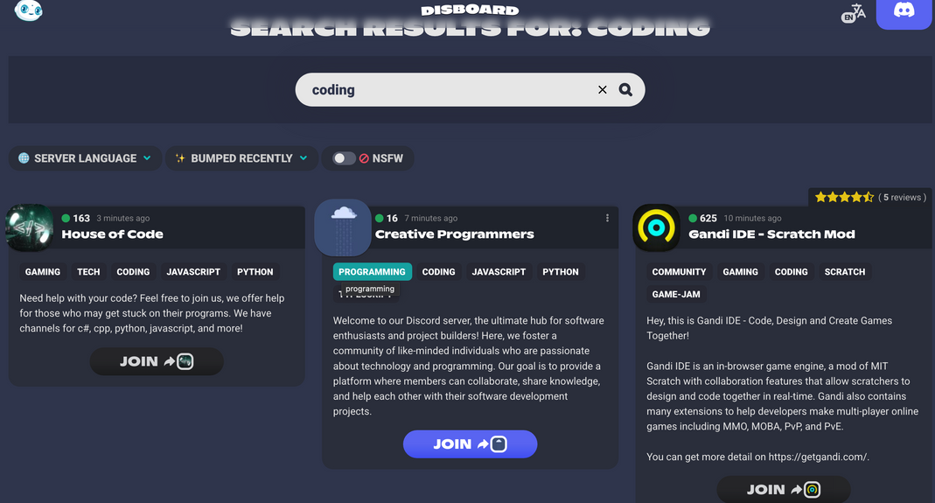

Appendix 1a: Expanding Reach
How do we burgeon outreach?
Creation of a community discord server and allowing open access via a link on our platform AND promoting it on Disboard, we can grow our community!
The discord server would be to utilised to raise awareness of our platform AND provide regular updates of application’s downtimes and maintainence periods
Notes:
However, our group was sceptical about the author's claim and upon further research, found that scenario planning is not necessarily an antidote for overconfidence. An MIT SLOAN study found that their participants were almost equally likely to become more or less confident in their judgement before and after scenario planning. Their findings show that if you are already overconfident about your judgement, you won’t necessarily become humbled or less overconfident after exposure to different scenarios.

Slide 17
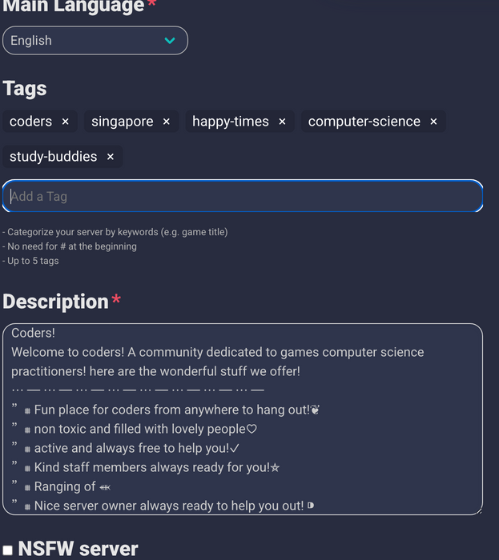
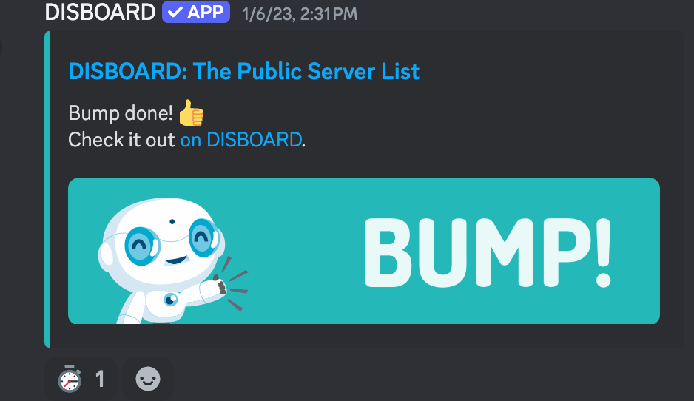
Appendix 1b: Expanding Reach
How to promote on Disboard?
Instructions
Add the Disboard bot to a server and give it all the permissions requested for.
Then, type /bump and they would prompt you to create a description on Disboard website first (Photo: Top Right)
(Add IMPORTANT keywords like ‘coding’ as it would be found by users who search the keyword)
Type /bump again in your to display your server on Disboard (Photo: Bottom Right)
Anyone in the server may bump every few hours to make the server be the first one that pops up on Disboard and be easily viewed by Disboard viewers

